Slide 1

Back to Basics
Principles of Sound

Slide 2
Overview
A Brief History of the [acoustics] Universe (Ruth)
Python setup
Acoustics Intro (Kait)
One dimensional oscillators, calculus refresher
Break!
Measurements (Kait)
Continuous/Impulsive
Python Bootcamp
Reading List, sound measurements and JASCO Pocket guide (reference)
https://tethys.pnnl.gov/sites/default/files/publications/jmse-09-00173.pdf
https://www.oceansinitiative.org/wp-content/uploads/2012/07/PocketBook-3rd-ed.pdf

Slide 3
Installing Python
Python requires ‘environments’. Consider this the library where all the books are held.
Environments Contain
Version of Python
Packages (libraries in R)
Plus: Not recommended to update packages once you have your environment set up.
Minus: Considerable changes between package and Python versions. Common to find compatibility issues
https://anaconda.org/

Slide 4
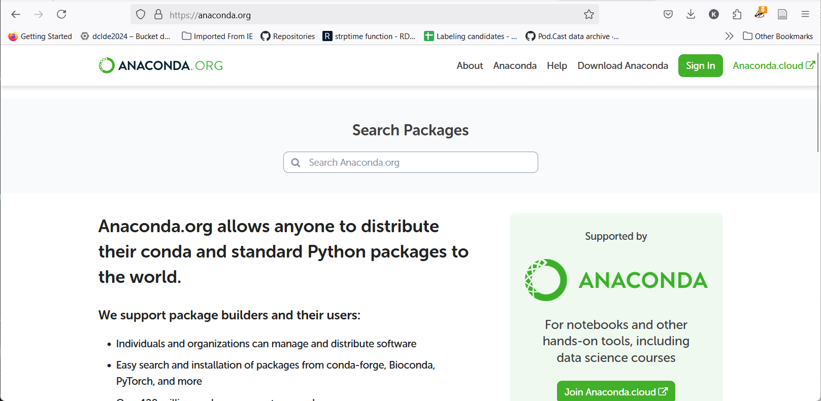
Getting Going
www.anaconda.org
Python 3.12.3

Slide 5
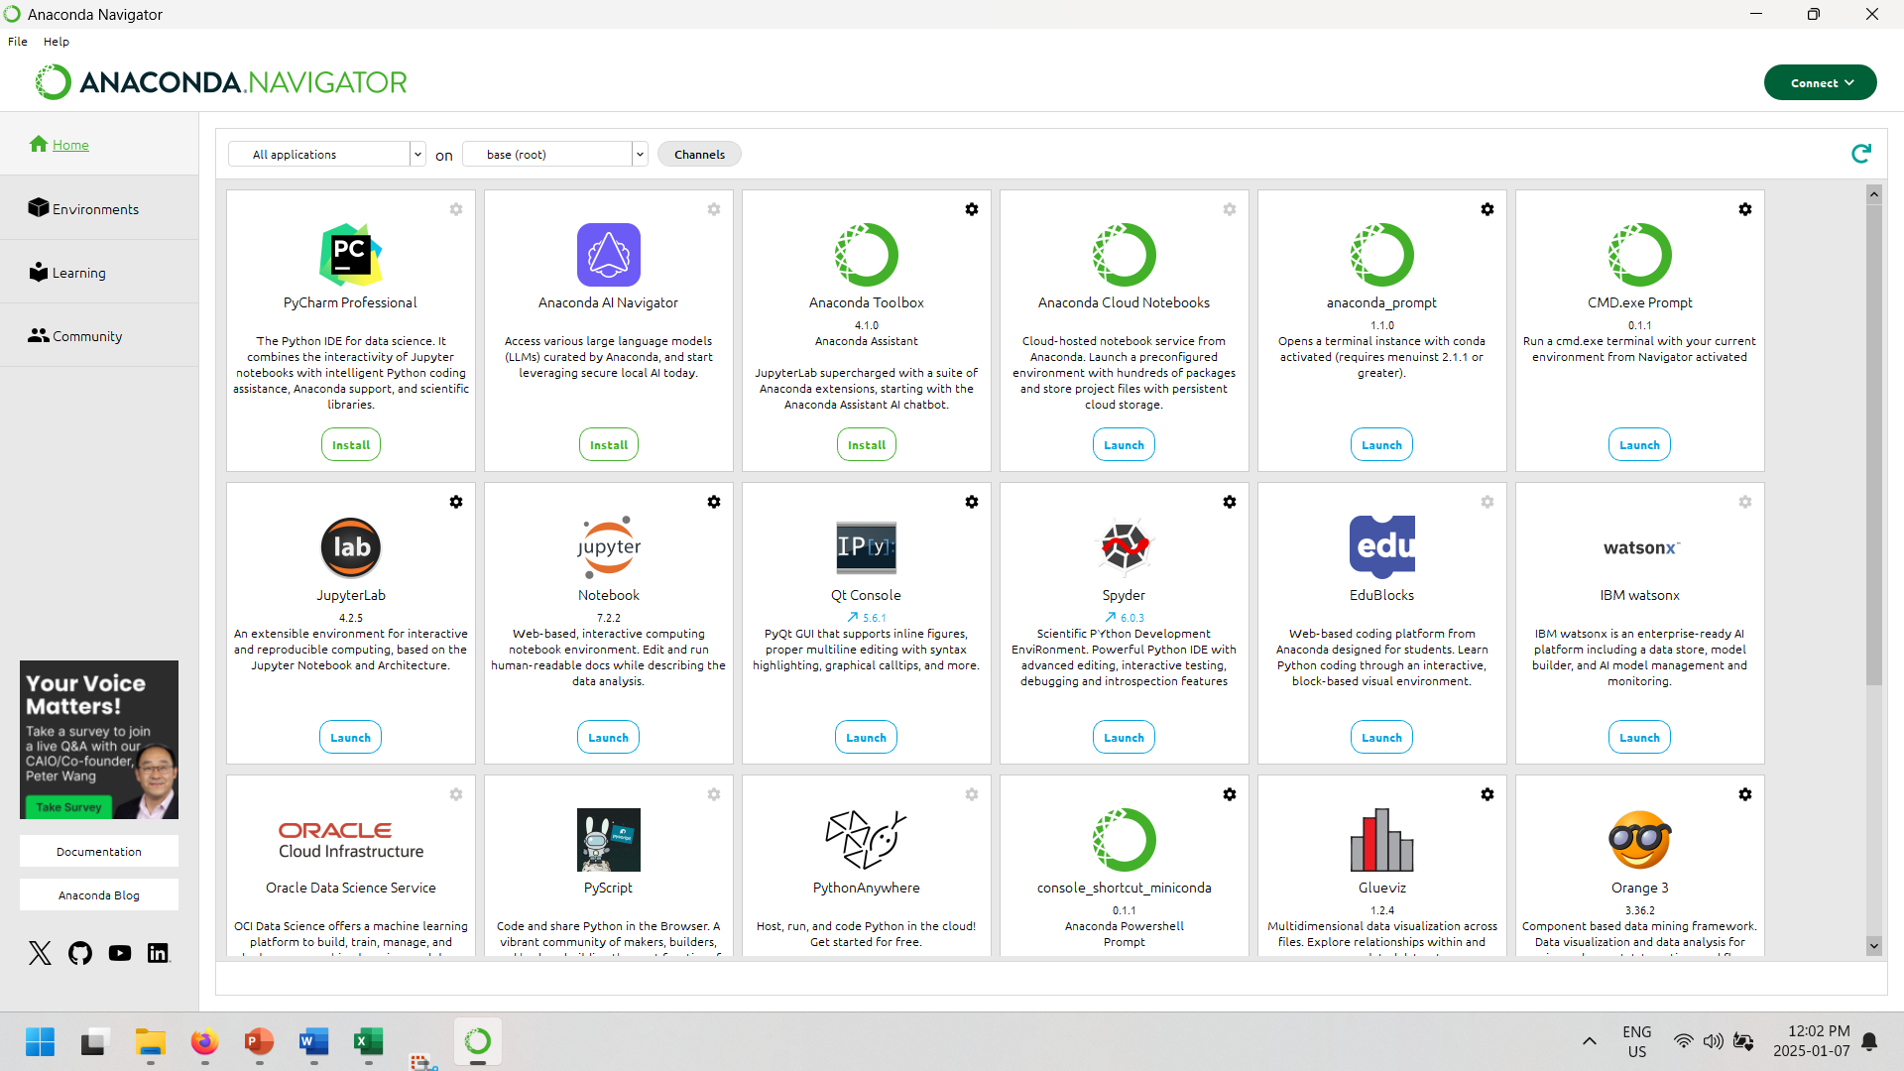

Slide 6

Python installation can be irritating
Deep breaths
Work with Kait
Google it (that’s what I do)
Figure out what works on your machine, as it may not work on mine

Slide 7
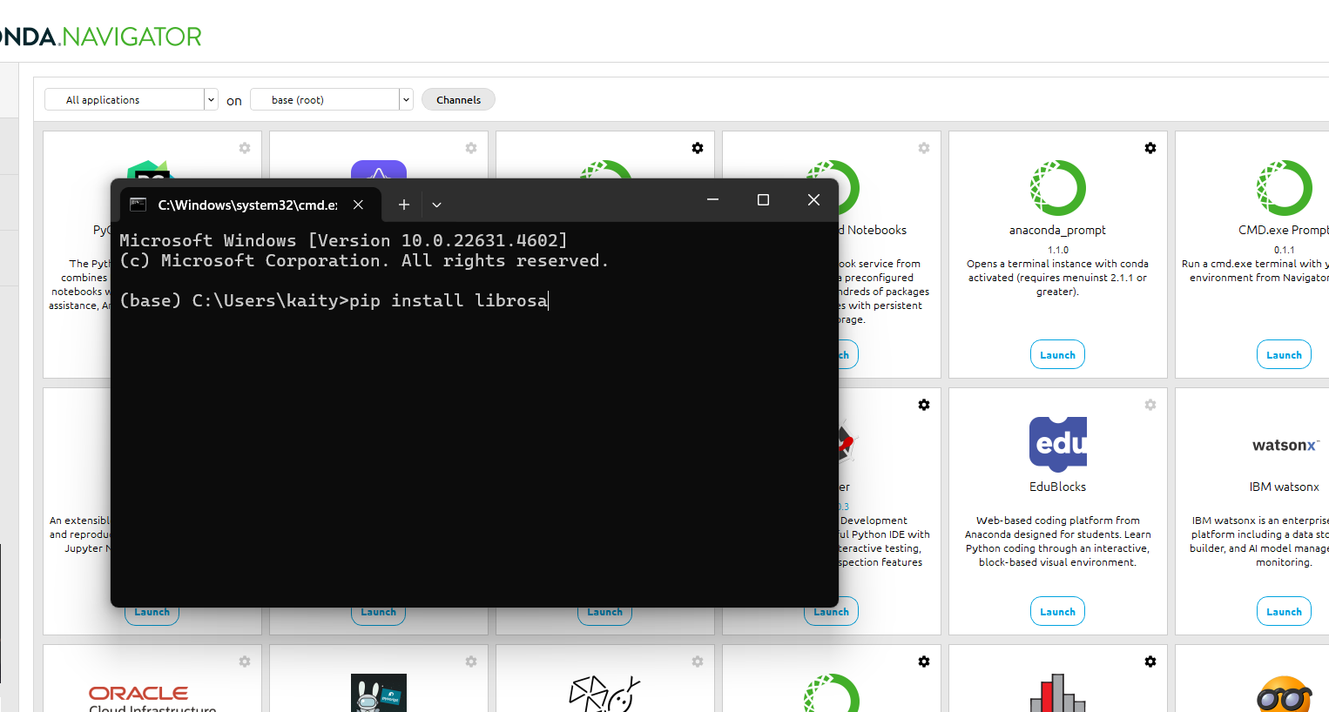
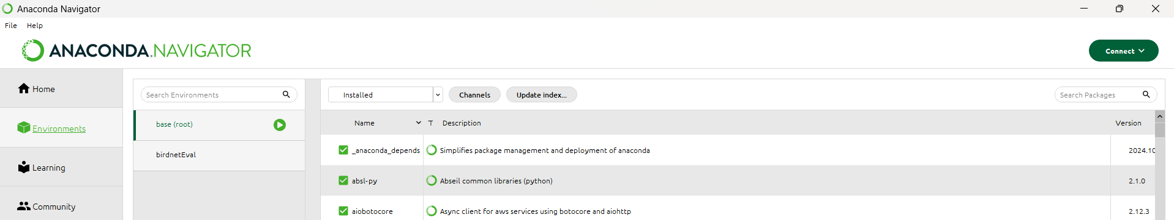
Installing Packages
From Anaconda- ok
Pip – better (think Cran)
Everyday libraries, numpy, pandas, librosa

Slide 8
Next time
One dimensional oscillator
Review derivatives of trigonometric functions (sin, cos, e^{x})
Reading partial differential equations
Solving the 1-d wave equation
Boundary conditions
Measurements

Slide 9
Python basics
Indentation matters!
Declaring variables, same as R/Matlab
Function == ‘definitions’
Doc strings
In spyder type “”” to generate documentation strings

Slide 10
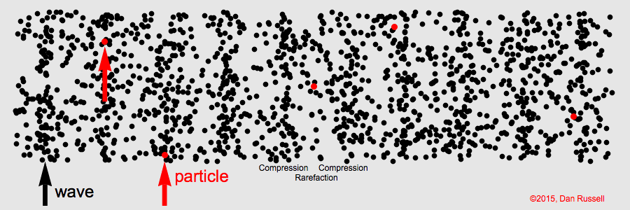
What is sound
Changes in density (compression and expansion)
Air, water, sound, electromagnetic, gravity

Slide 11
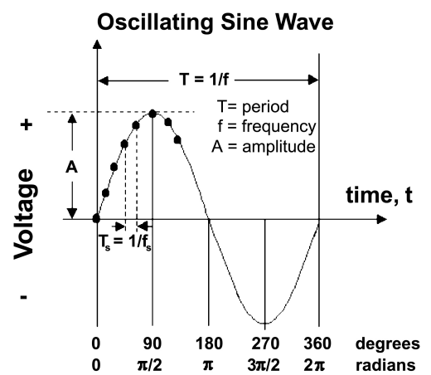
Critical measures:
Amplitude (A, unitless),
Wavelength (λ, m)
Period (τ,s)
Phase (ϕ, radians)
k - the wave number (1/λ),
ω - angular frequency (π/τ)

Slide 12
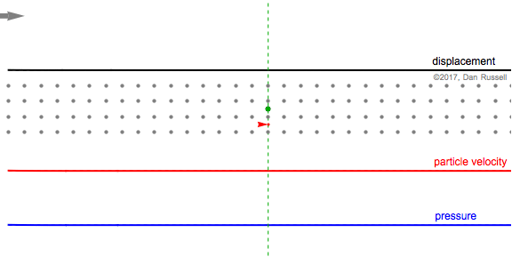
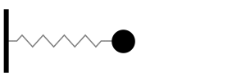
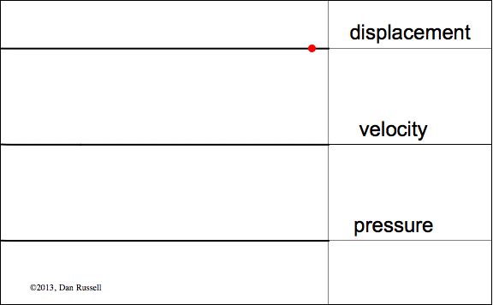
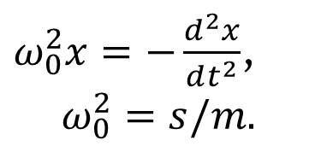
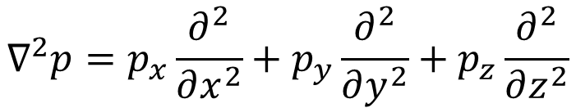
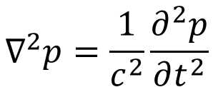
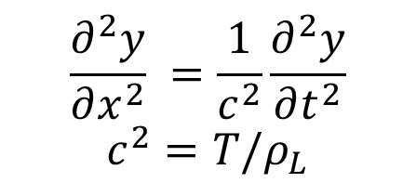
The wave equation
$ω_{0}^{2}x=−\frac{d^{2}x}{dt^{2}}$,
$$ω_{0}^{2}=s/m$$
0- DOF
$$\frac{∂^{2}y}{∂x^{2}} =\frac{1}{c^{2}}\frac{∂^{2}y}{∂t^{2}}$$
$$c^{2}=T/ρ_{L}$$
1- DOF
3- DOF
$$∇^{2}p=\frac{1}{c^{2}}\frac{∂^{2}p}{∂t^{2}}$$
$$∇^{2}p=p_{x}\frac{∂^{2}}{∂x^{2}}+p_{y}\frac{∂^{2}}{∂y^{2}}+p_{z}\frac{∂^{2}}{∂z^{2}}$$
https://www.acs.psu.edu/drussell/Demos/SHO/mass.html

Slide 13
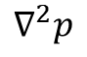
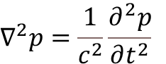
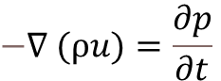
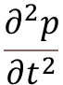
$$−∇ (ρu)=\frac{∂p}{∂t}$$
A change in particle velocity leads to a change in pressure. The pressure drives the particle motion, which feeds back into pressure changes, completing the cycle of wave propagation.
$$∇^{2}p=\frac{1}{c^{2}}\frac{∂^{2}p}{∂t^{2}}$$
$$∇^{2}p$$
How the second derivative of pressure varies spatially in all directions.
$$\frac{∂^{2}p}{∂t^{2}}$$
how pressure changes over time (its second derivative with respect to time)
if pressure varies spatially, it drives temporal acceleration

Slide 14
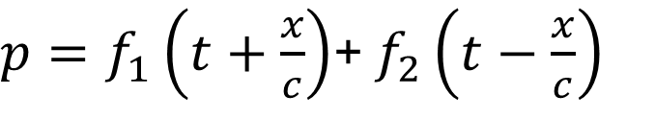
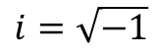
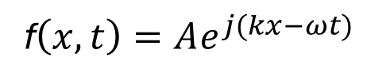
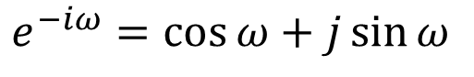
Important Relationships:
Wave moving +x
Wave moving -x
c =λf
k=ωc, ω = c/k
k=2π/ λ
$p=f_{1}\left(t+\frac{x}{c}\right)$+ $f_{2}\left(t−\frac{x}{c}\right)$
Some fun. f₁
Some fun. f₂
f$\left(x,t\right)=Ae^{j(kx−ωt)}$
$$i=\sqrt{−1}$$
Real part (amplitude)
$e^{−iω}=\cos{ω⁡}+j\sin{ω}$
Imaginary/complex part (phase)

Slide 15
MATH BREAKOUT!

Slide 16
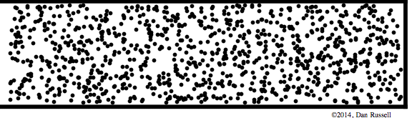
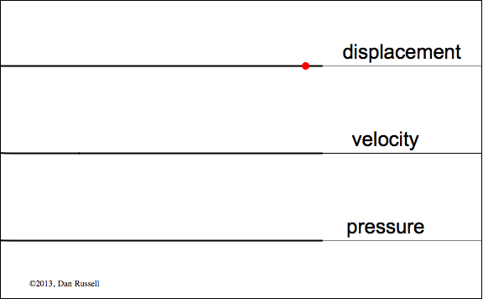
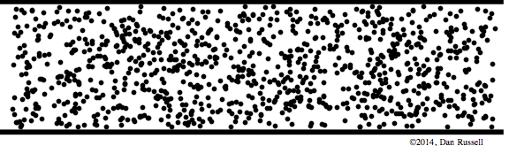
Boundary Conditions
Rigid, fixed; Displacement & velocity=0
Free, pressure release; pressure =0
https://www.acs.psu.edu/drussell/Demos/SHO/mass.html

Slide 17
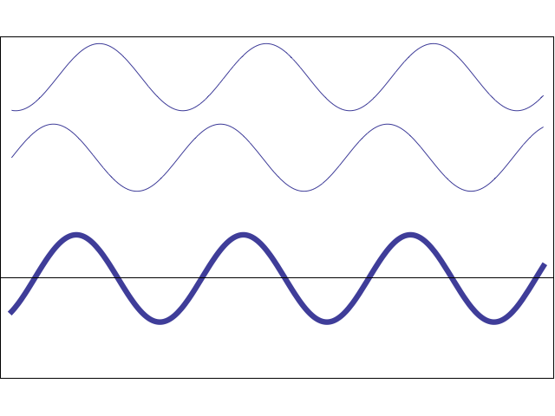
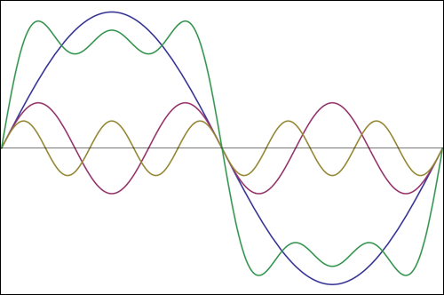
Interactions
Most sound combination of different harmonic waves at different amplitudes and frequencies
Results in constructive and destructive interference
Can sum multiple harmonic waves to make any shape
$A\sin\left(ωt±kx\right)+A\sin\left(ωt±kx+φ\right)=2A\cos\left(\frac{φ}{2}\right)∗\sin\left(ωt±kx+φ/2\right)$

Slide 18
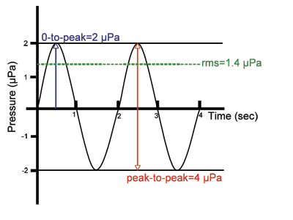
Measurements
0-to peak
RMS
Peak-to-peak

Slide 19
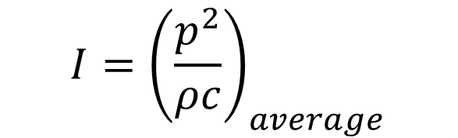

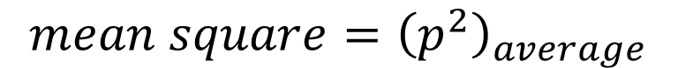
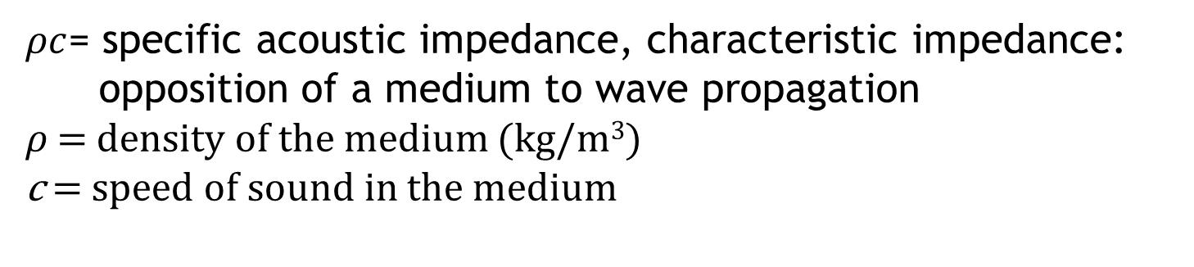
Measurements
Intensity- amount of energy transmitted per unit time through a unit area
$$I={\left(\frac{p^{2}}{ρc}\right)}_{average}$$
$$mean square={\left(p^{2}\right)}_{average}$$
$${rms=\sqrt{p^{2}}}_{average}$$
$ρc$= specific acoustic impedance, characteristic impedance:
opposition of a medium to wave propagation
𝜌 = $density of the medium$ (kg/m³)
c = speed of sound in the medium

Slide 20
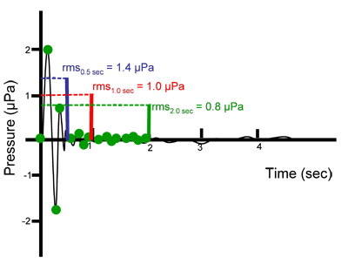
Impulsive Signals
Duration over which signal is averaged | rms pressure
0.5 sec | 1.4 µPa
1 sec | 1.0 µPa
2 sec | 0.8 µPa
www.dosits.org

Slide 22
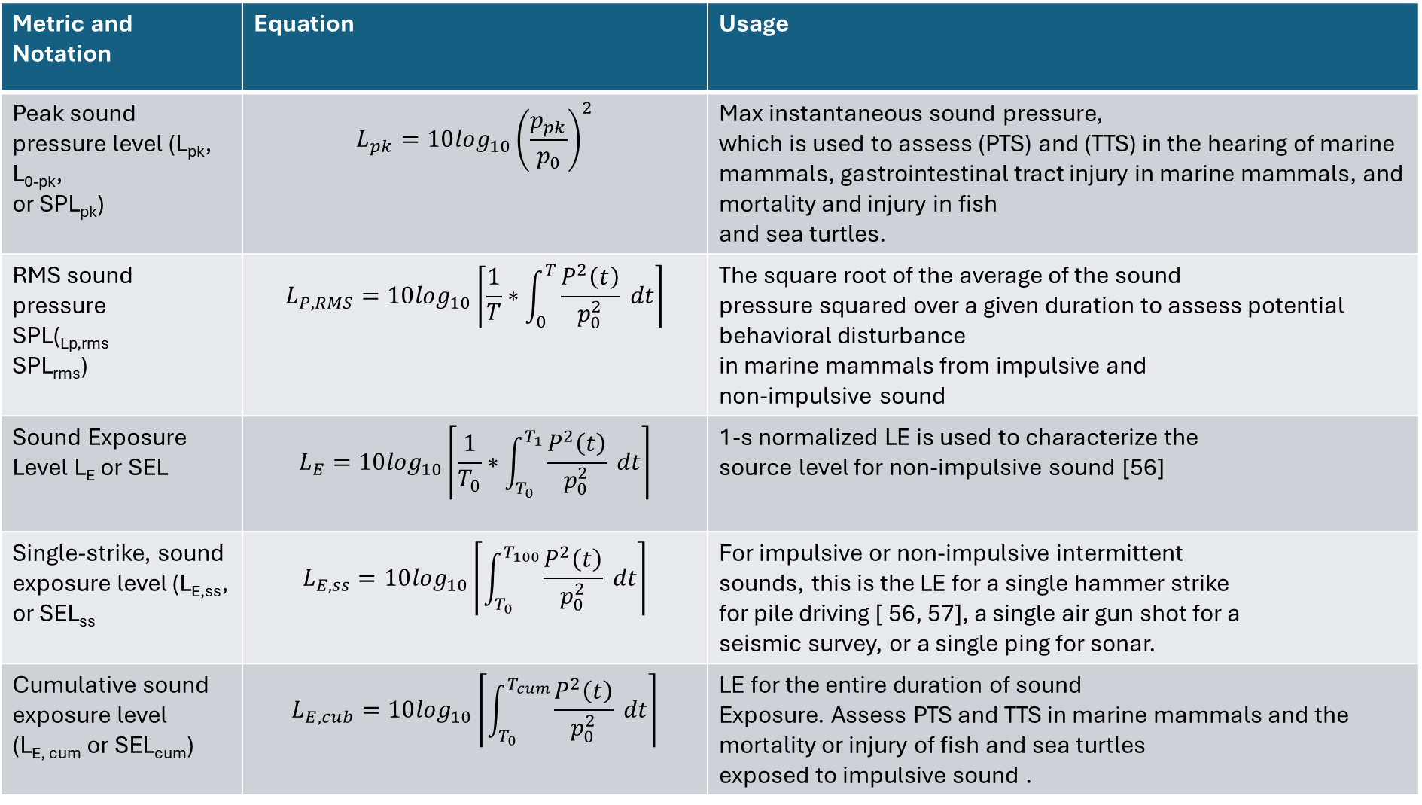
Metric and Notation | Equation | Usage
Peak sound pressure level (L_{pk}, L_{0-pk}, or SPL_{pk}) | $$L_{pk}=10\log_{10}{\left(\frac{p_{pk}}{p_{0}}\right)}^{2}$$ | Max instantaneous sound pressure, which is used to assess (PTS) and (TTS) in the hearing of marine mammals, gastrointestinal tract injury in marine mammals, and mortality and injury in fish and sea turtles.
RMS sound pressure SPL(_{Lp,rms} SPL_{rms}) | $$L_{P,RMS}=10\log_{10}\left\lceil \frac{1}{T}∗\int_{0}^{T}{\frac{P^{2}\left(t\right)}{p_{0}^{2}}} dt\right\rceil$$ | The square root of the average of the sound pressure squared over a given duration to assess potential behavioral disturbance in marine mammals from impulsive and non-impulsive sound
Sound Exposure Level L_{E} or SEL | $$L_{E}=10\log_{10}\left\lceil \frac{1}{T_{0}}∗\int_{T_{0}}^{T_{1}}{\frac{P^{2}\left(t\right)}{p_{0}^{2}}} dt\right\rceil$$ | 1-s normalized LE is used to characterize the source level for non-impulsive sound [56]
Single-strike, sound exposure level (L_{E,ss}, or SEL_{ss} | $$L_{E,ss}=10\log_{10}\left\lceil \int_{T_{0}}^{T_{100}}{\frac{P^{2}\left(t\right)}{p_{0}^{2}}} dt\right\rceil$$ | For impulsive or non-impulsive intermittent sounds, this is the LE for a single hammer strike for pile driving [ 56, 57], a single air gun shot for a seismic survey, or a single ping for sonar.
Cumulative sound exposure level (L_{E, cum} or SEL_{cum}) | $$L_{E,cub}=10\log_{10}\left\lceil \int_{T_{0}}^{T_{cum}}{\frac{P^{2}\left(t\right)}{p_{0}^{2}}} dt\right\rceil$$ | LE for the entire duration of sound Exposure. Assess PTS and TTS in marine mammals and the mortality or injury of fish and sea turtles exposed to impulsive sound .
https://tethys.pnnl.gov/sites/default/files/publications/jmse-09-00173.pdf

